Slide 1
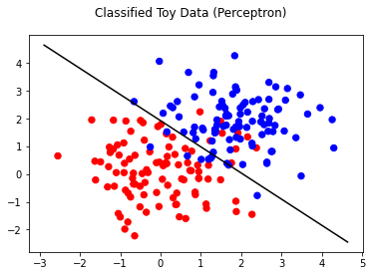
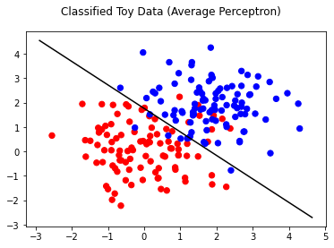
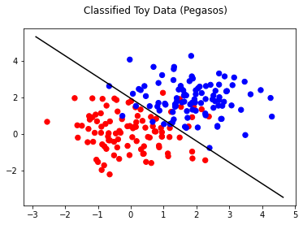
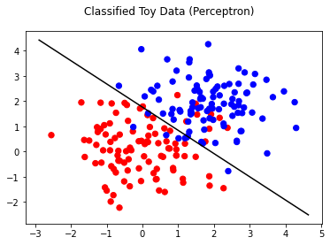
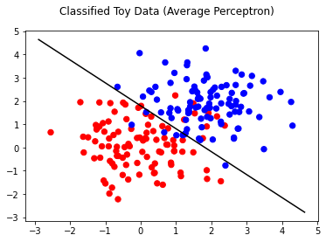
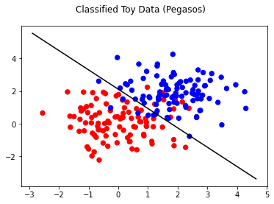


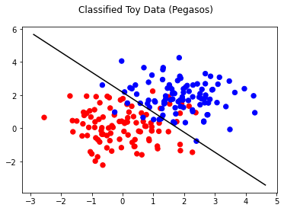
T = 10
theta - 3.9173, 4.164
theta_0 - -8.0
theta - 3.478, 3.6110
theta_0 - 6.373
theta - 0.7346, 0.6300
theta_0 -1.219
T = 50
theta - 3.6510, 3.9679
theta_0 - -7
theta - 3.9480, 4.0051
theta_0 -7.184
theta - 0.6951, 0.5865
theta_0 - -1.2425
T = 100
theta - 3.9264,3.5205, theta_0 - -7
theta - 3.8735,3.8802
theta_0 -7.0129
theta - 0.6895,0.5714
theta_0 - -1.2426

